Slide 1
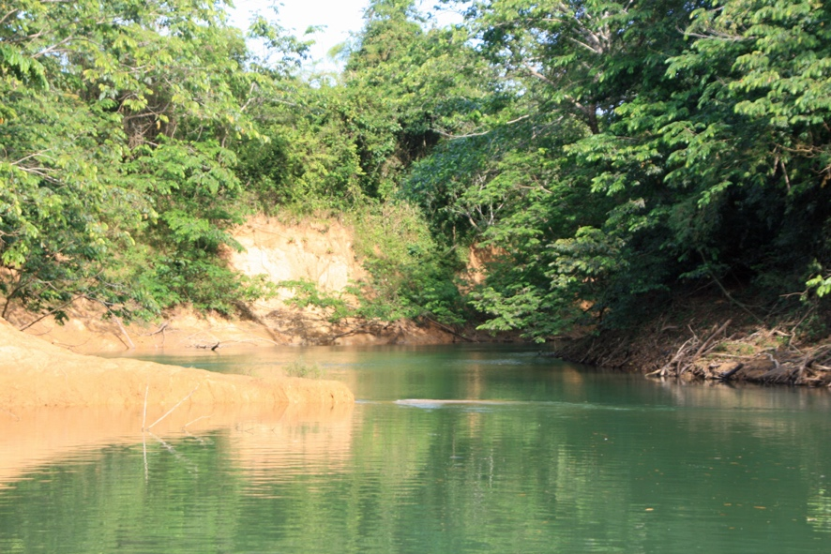
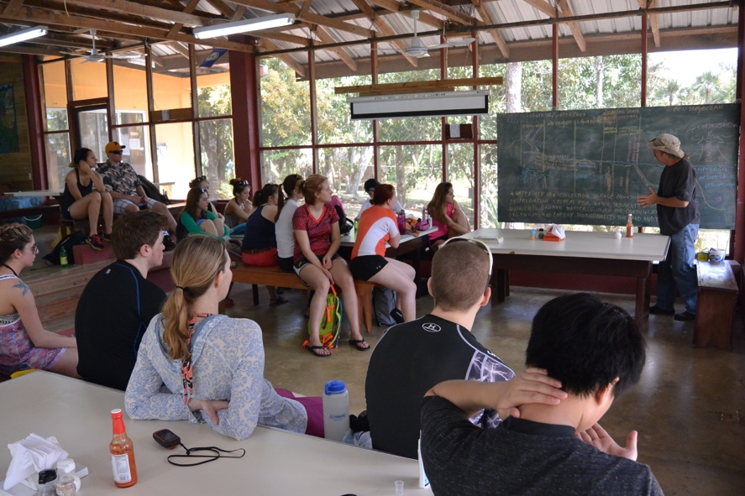
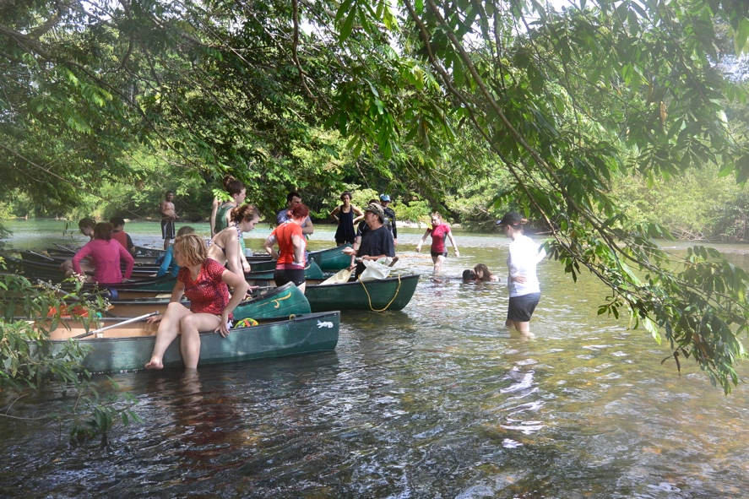
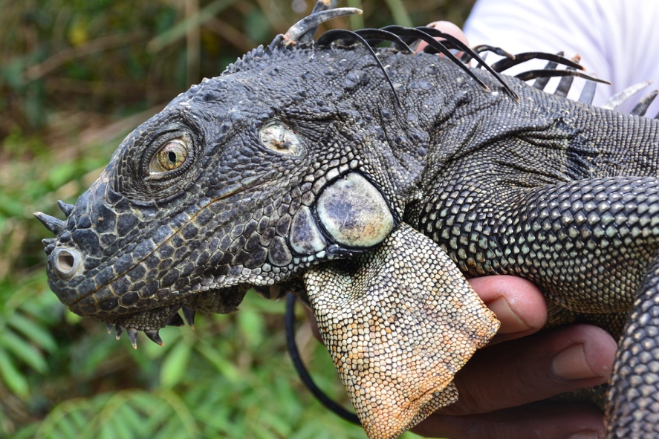
Scaling research ideas to fit the study abroad experience

Slide 2
Ideas that have worked well for me
Start early…if possible, before you leave
Provide relatively straightforward paper(s) from literature for students to use as models
Select topics that excite students, emphasize opportunity to apply and expectations
Options to focus educational goals
Focus on pilot data collection that would inform experimental design for a full research project
Focus on experimental design and developing those skills
Consider using peer-reviewed papers as source for building educational materials
Skill development for field and/or lab procedures
Lessons learned and ways to adapt are as valuable as a dataset

Slide 3
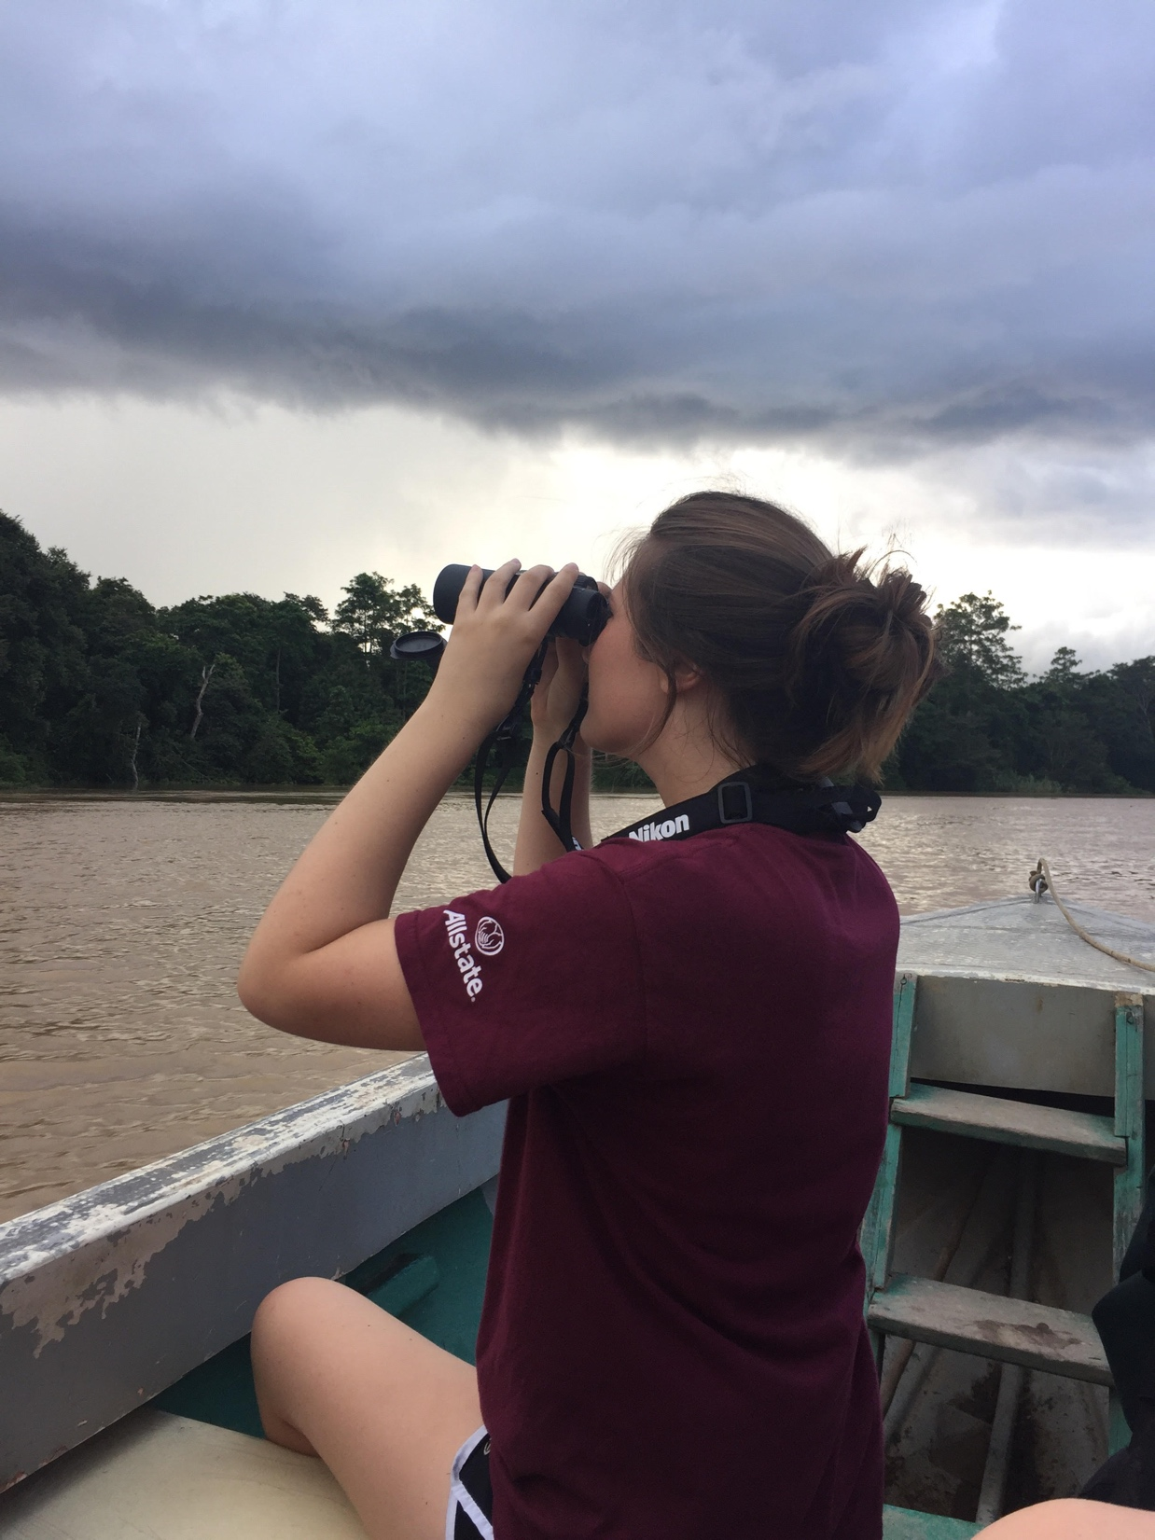
Keep asking “What did you learn?” and “What would you do next?”

Slide 4
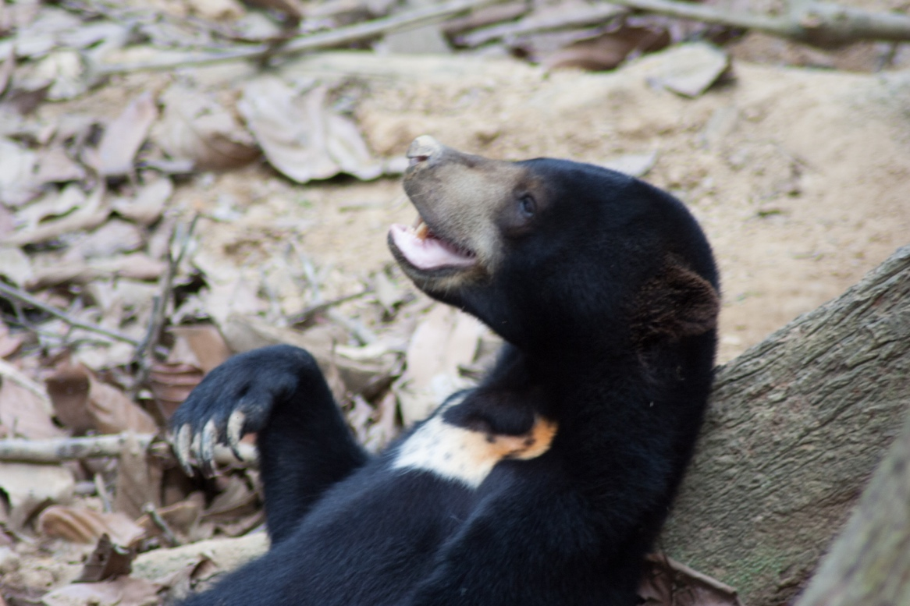
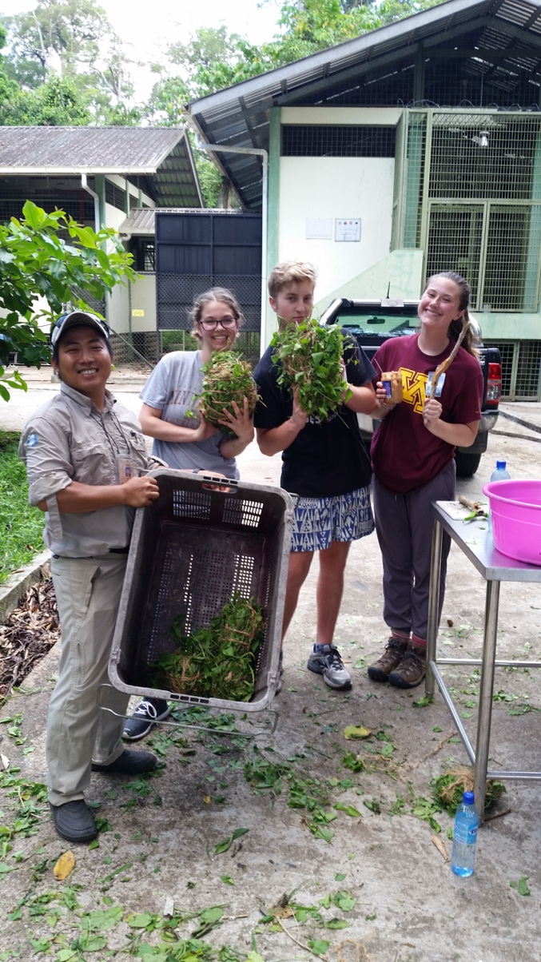
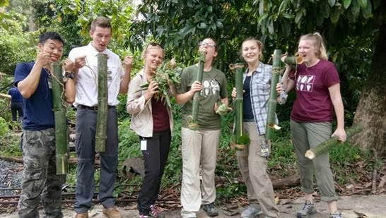
Start early…if possible, before you leave
Global Seminar
Informal meetings to build knowledge prior to departure
Allow student interest to guide topics
Use short videos and papers (context)
Focus on getting to know each other and develop ideas into something students intend to implement

Slide 5
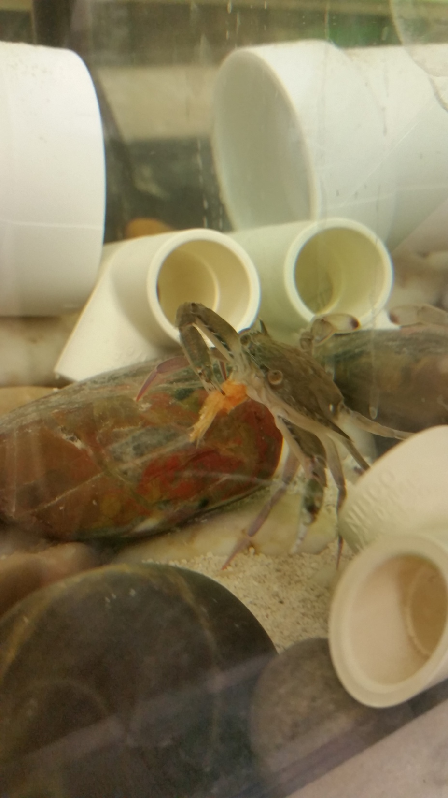
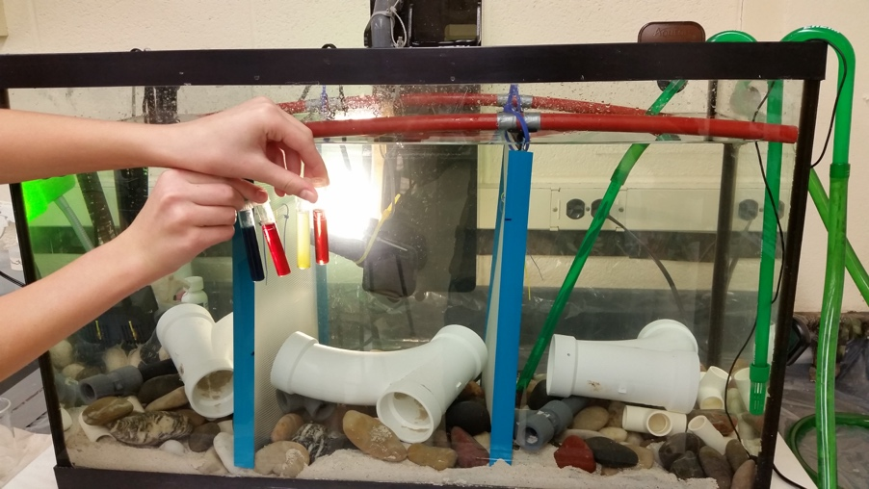
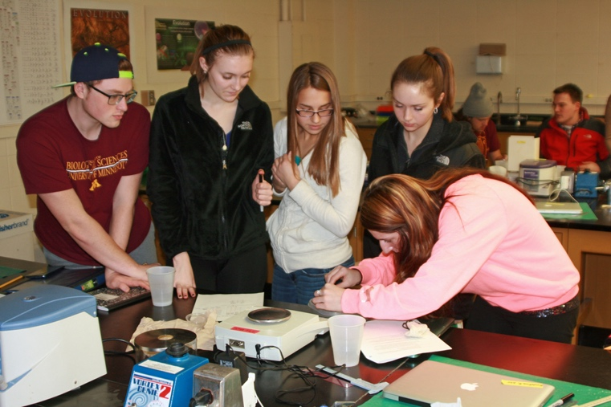
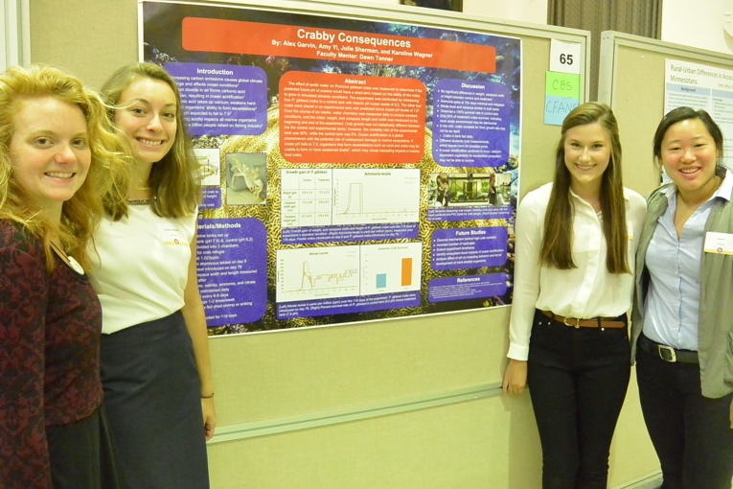
Start early…if possible, before you leave
Freshman Seminar
Formal class sessions provide opportunity to go deeper
Conversations with researchers (Skype)
Papers, sample experiment that builds key skills/conceptual knowledge
Design new experiment prior to departure (Tools needed?)
Emphasize: Design to the absolute best of your ability understanding that will give you the ability to adapt when you arrive and try the design

Slide 6
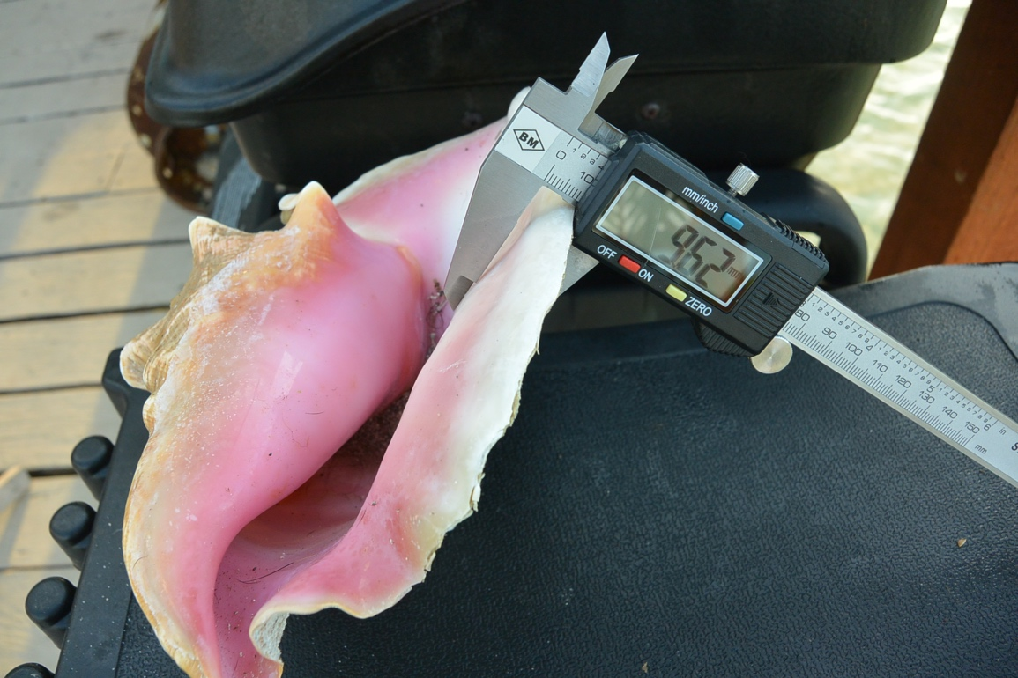
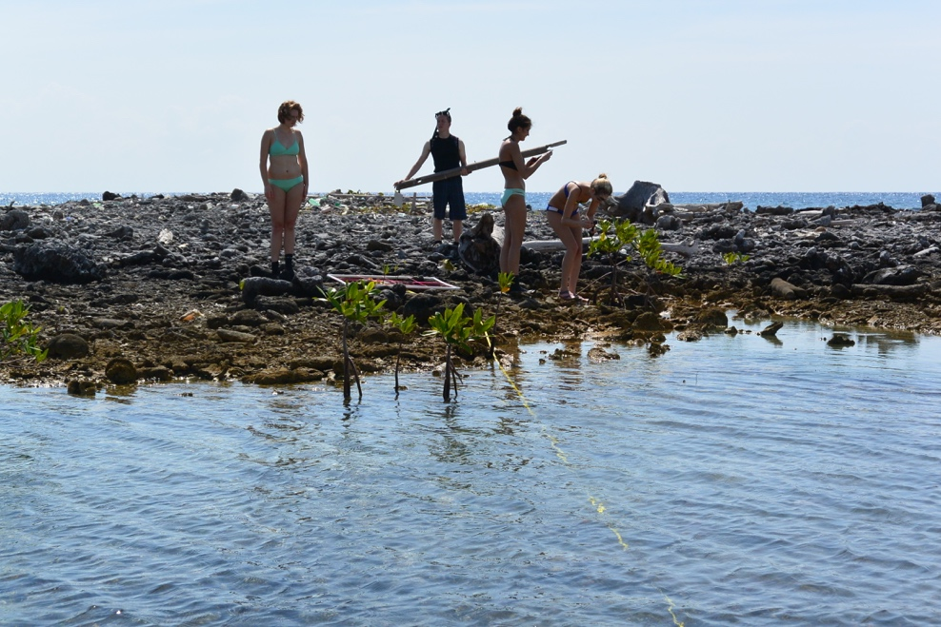
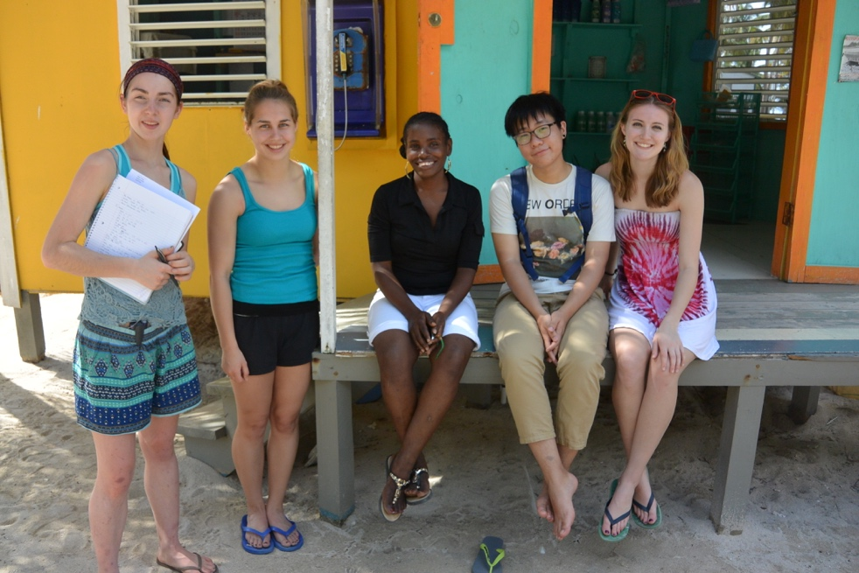
Take preliminary design into the field, and see what happens

Slide 7
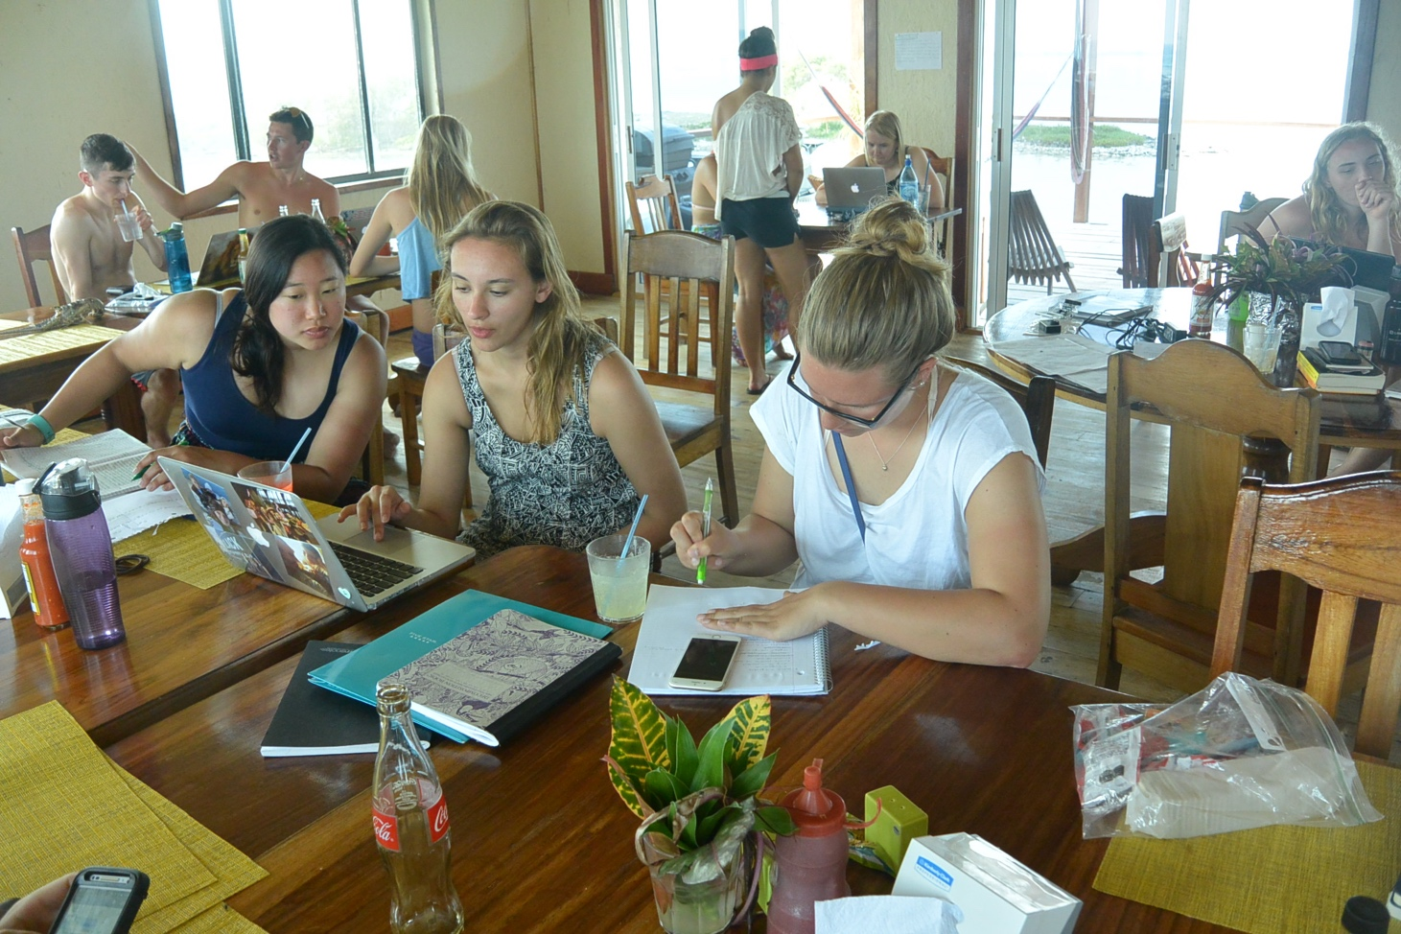
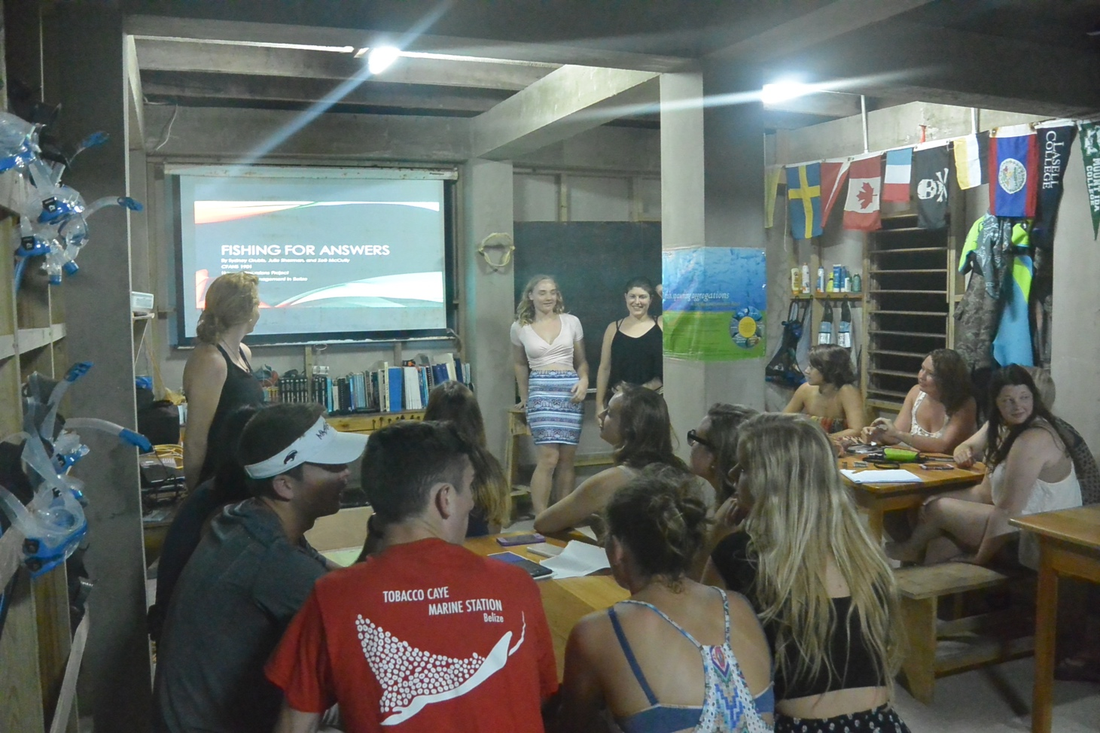
Whatever happens, how did you adapt, and what lessons did you learn?

Slide 8
lessons in sequence to build research skills
Borneo class: Learn and apply new skills
ID for species, simple independent (coral health) and dependent variables (species/count)
What would you change?
Where did you struggle?
Where did you feel confident?
ANOVA/Tukey’s Pairwise Comparisons in JMP

Slide 9
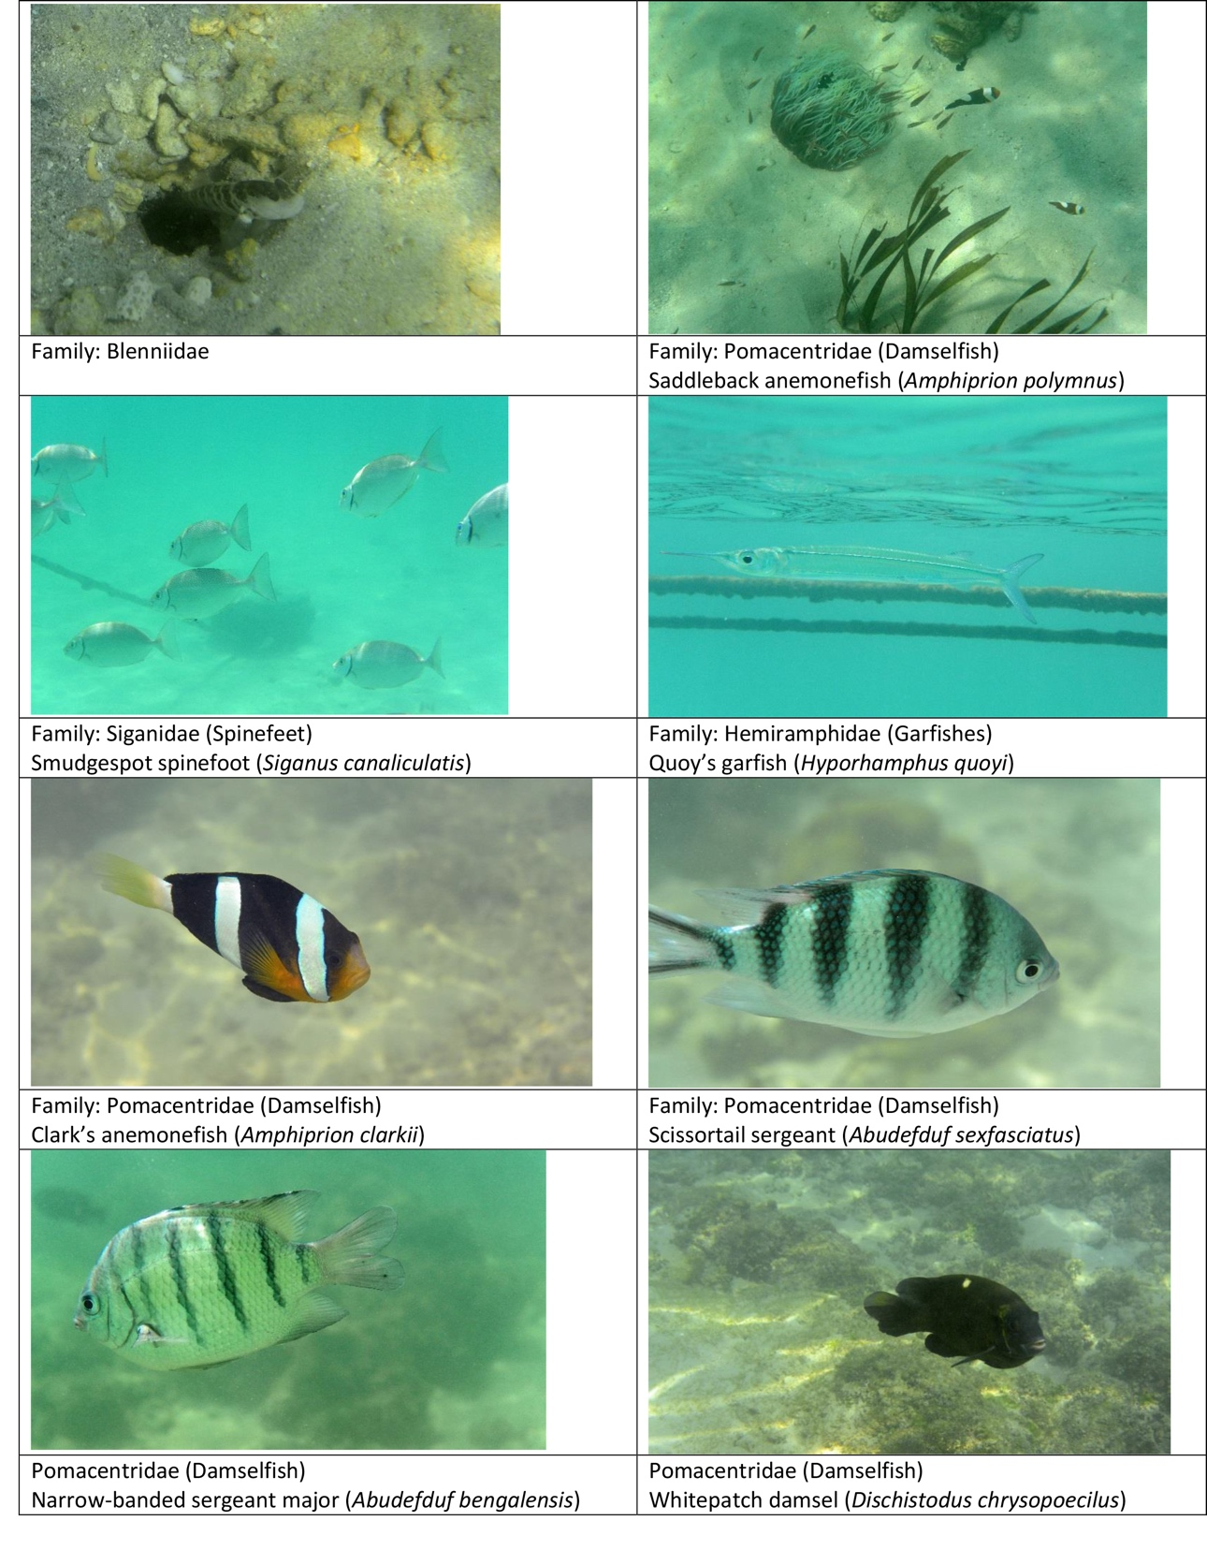
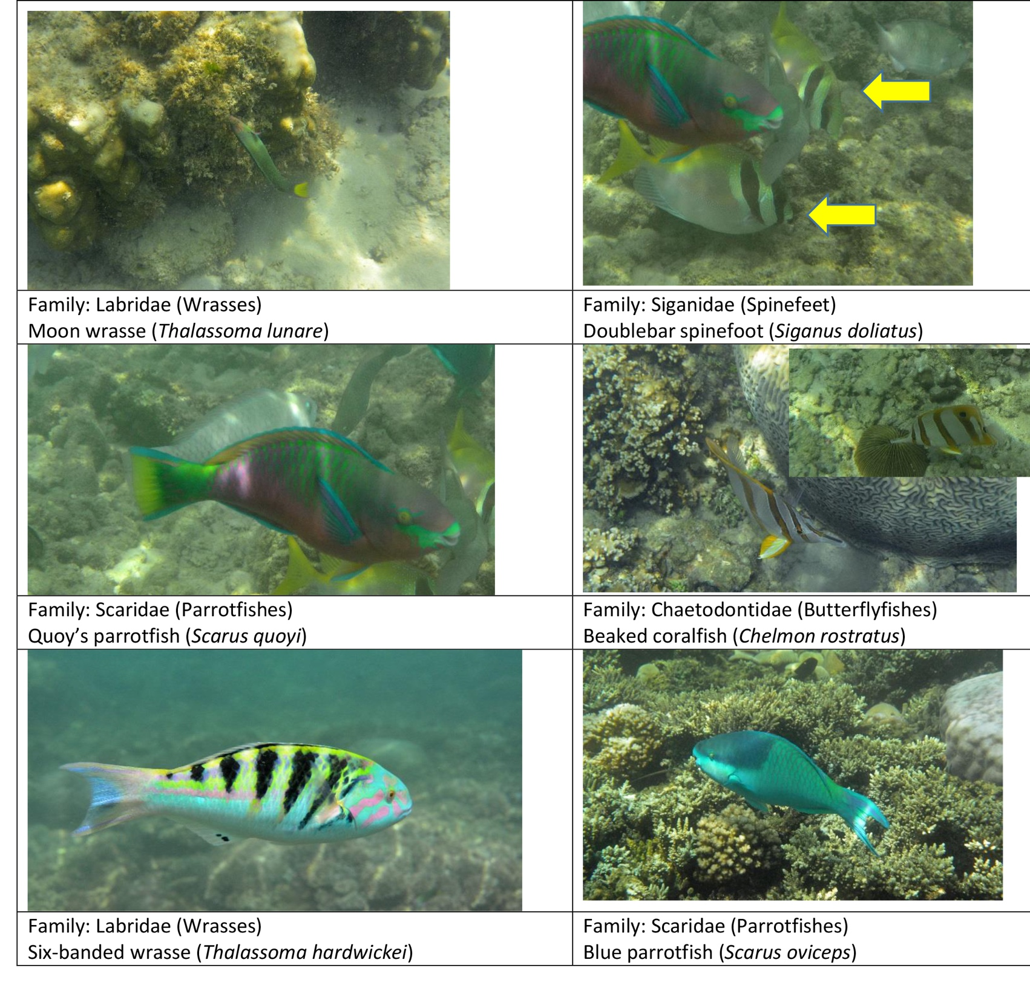

Slide 10
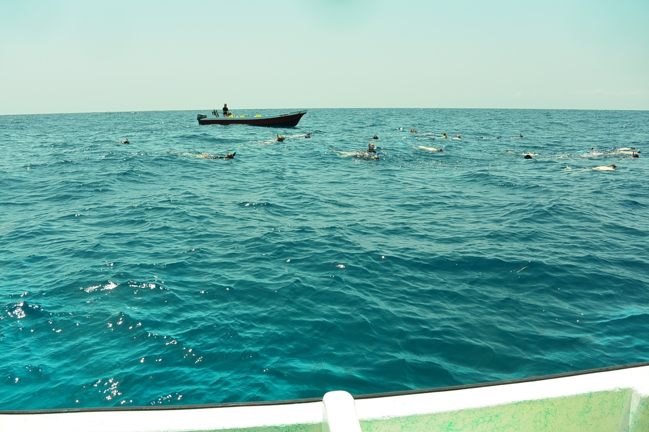
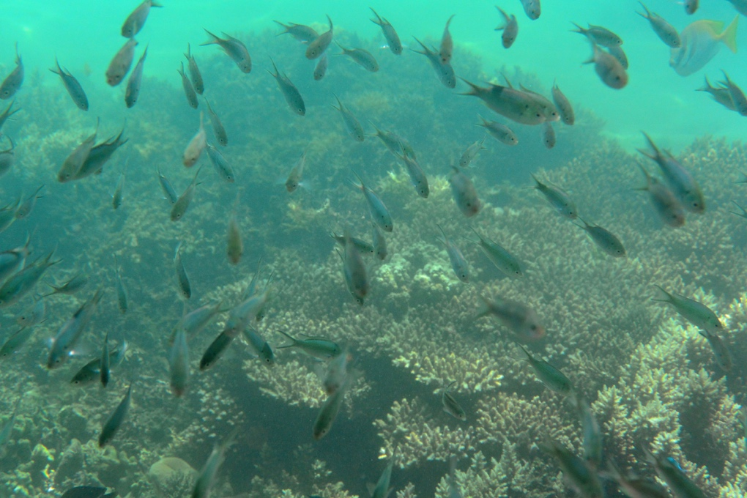
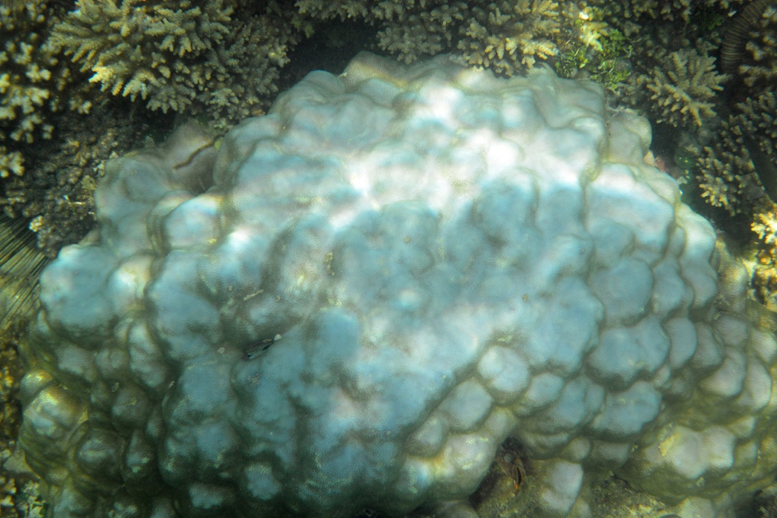
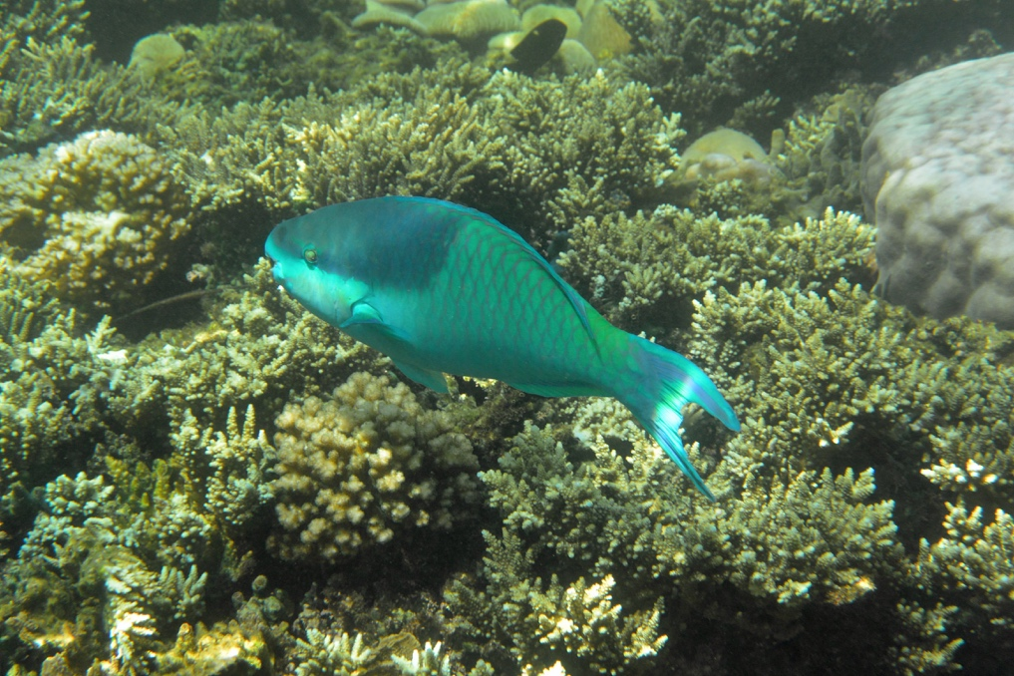
Students apply new ID skills with objective in mind

Slide 11
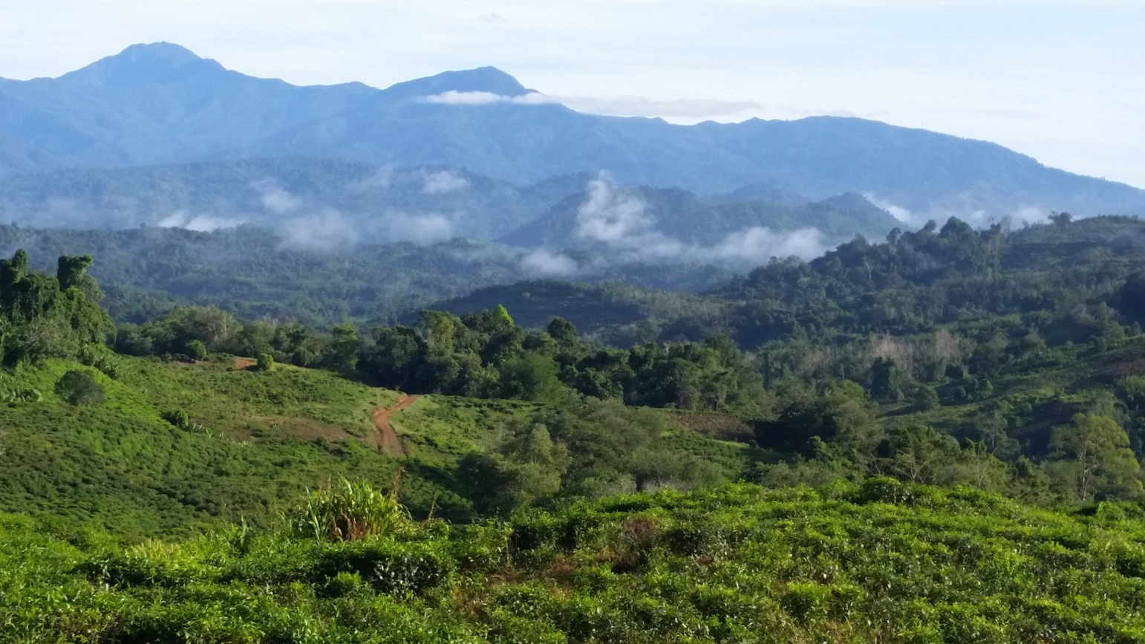
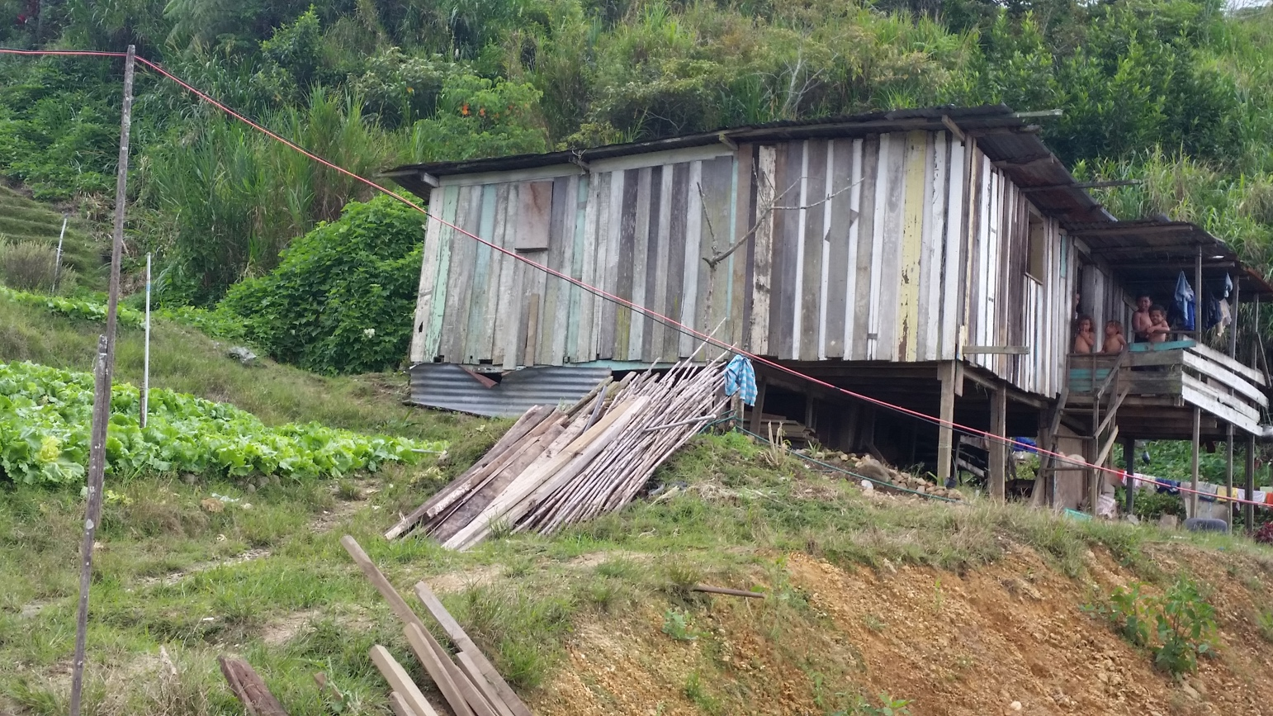
T-test for 10-min. timed swims

Slide 12
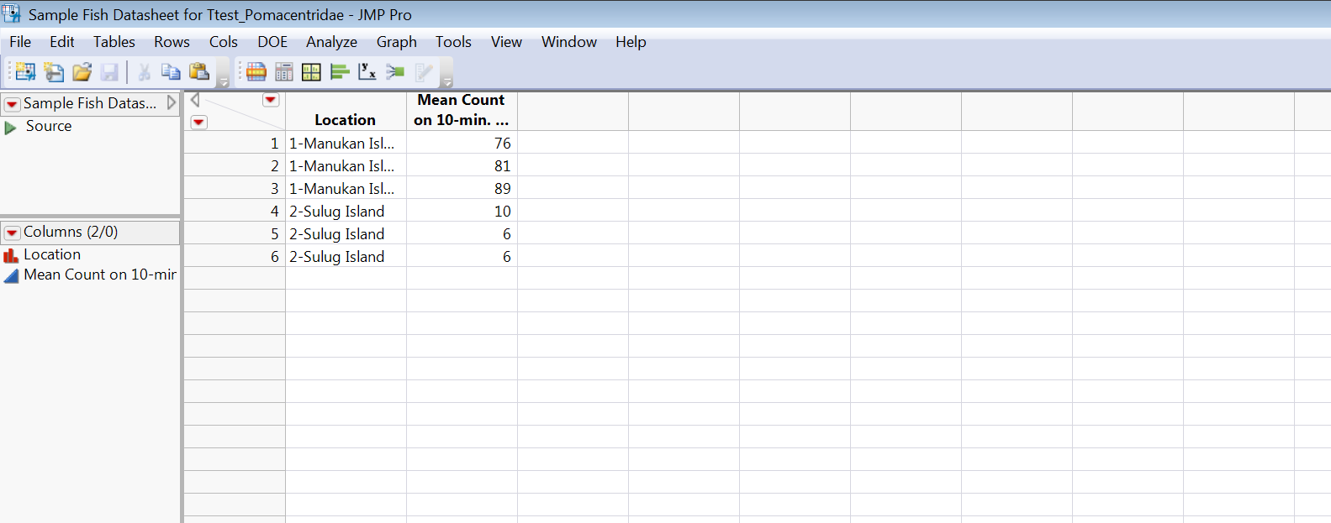
Pomacentridae

Slide 13
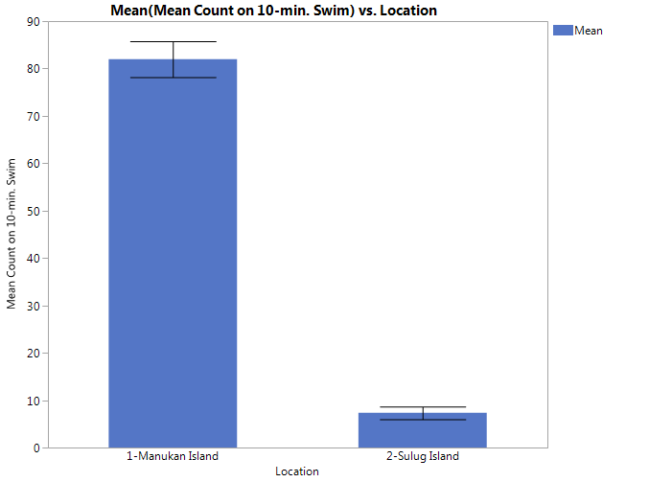
Pomacentridae

Slide 15
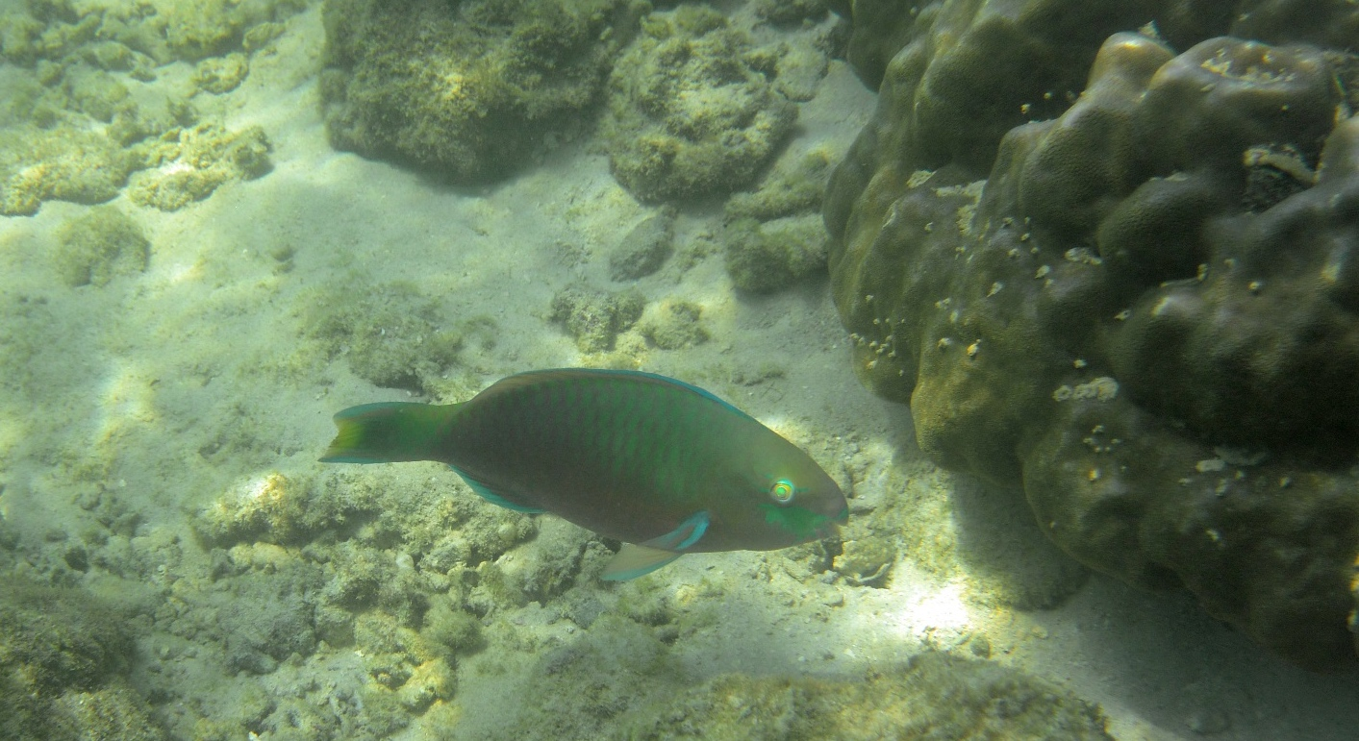
Scaridae

Slide 16
Scaridae

Slide 18
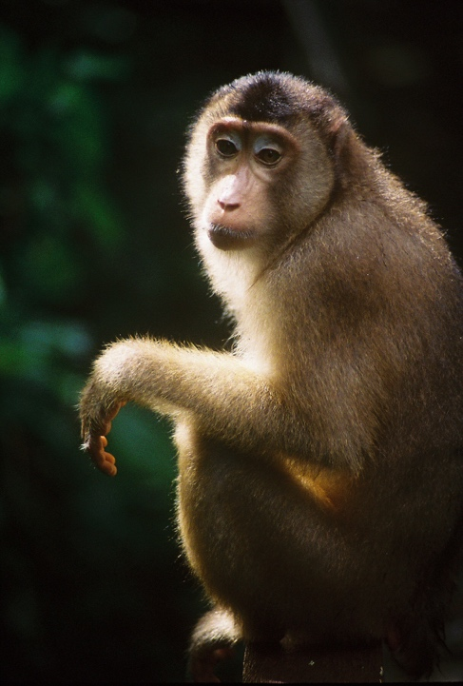
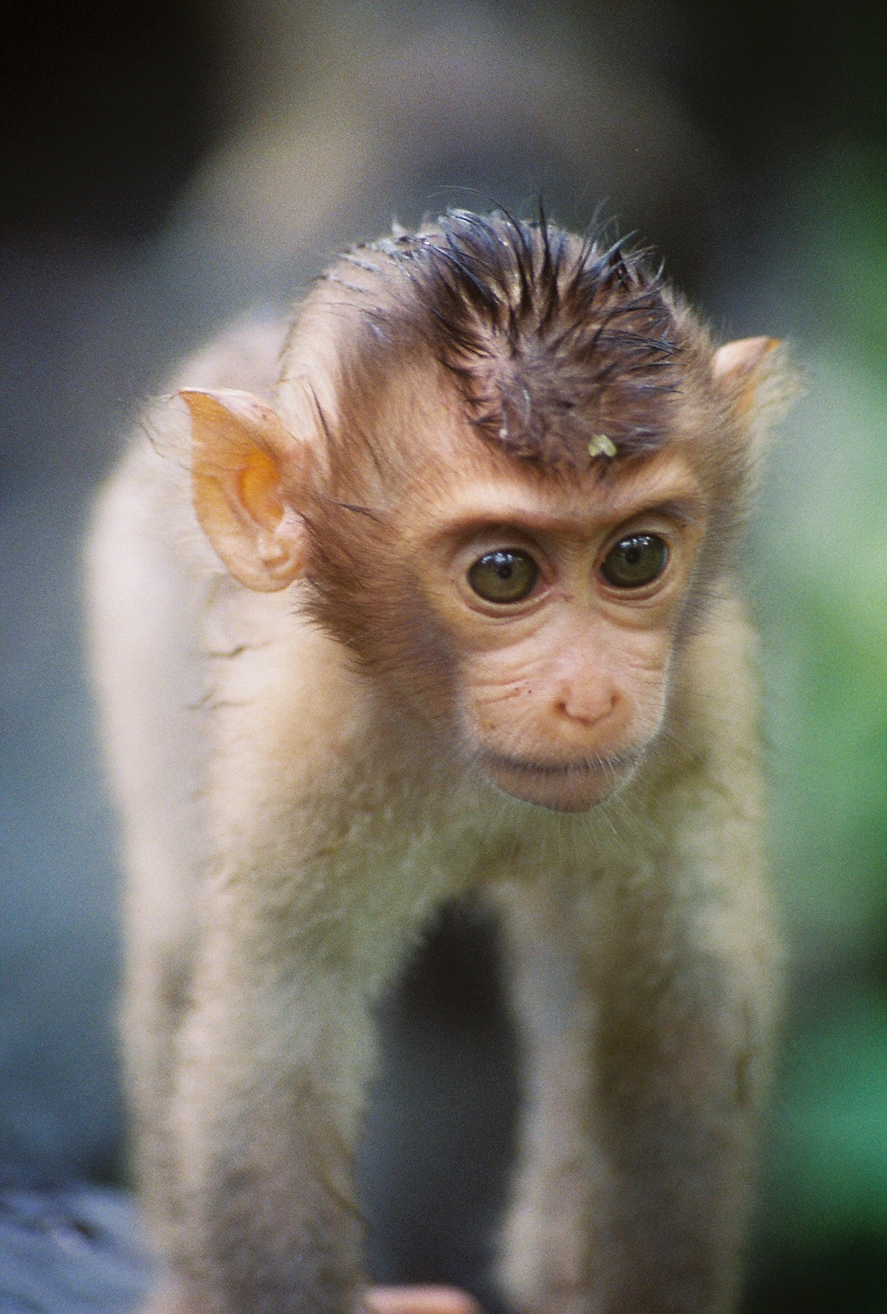
Lessons in sequence expanding research skills
Started with ID
Expand to behavior
Mini-lecture on how to do sampling (e.g., focal animal vs. scan), sample datasheet for each type, possible behavior codes, research papers on focal species
Small group: Design mini-experiment with goal: What will you ask? How will you apply sampling method? Develop datasheet, and apply
Product: Mini presentations on lessons learned and how experience would inform revision for full study

Slide 19
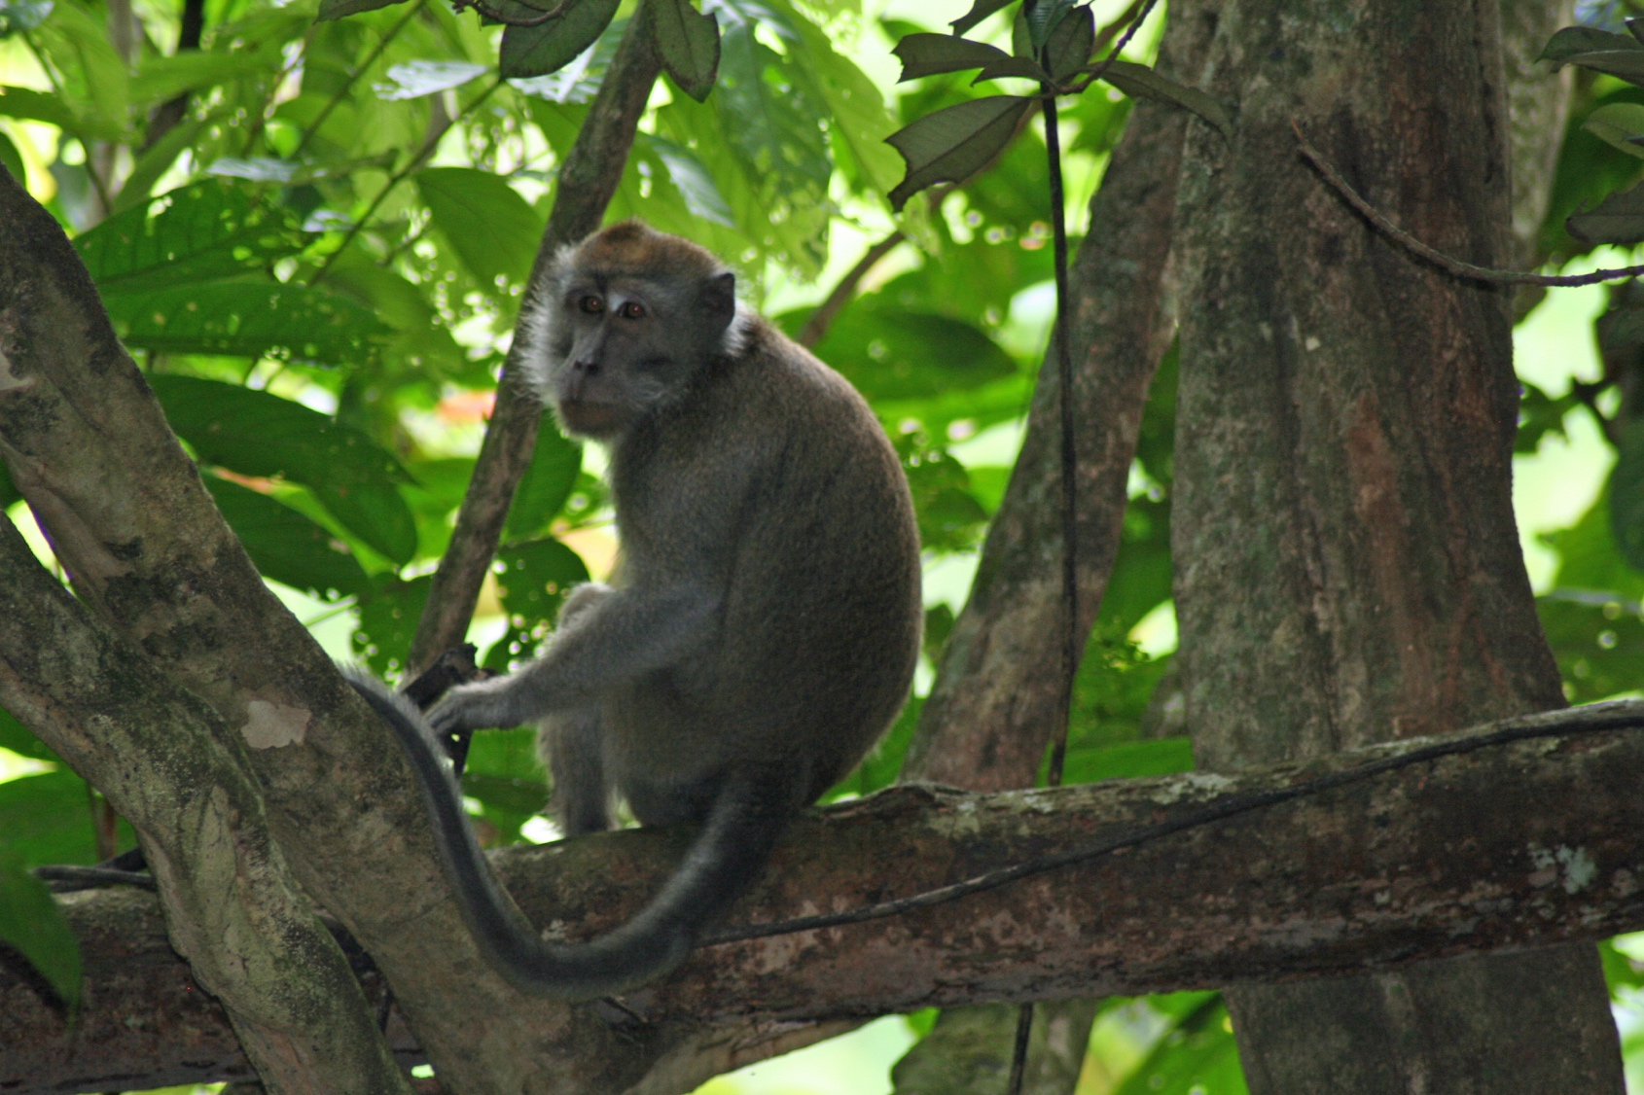
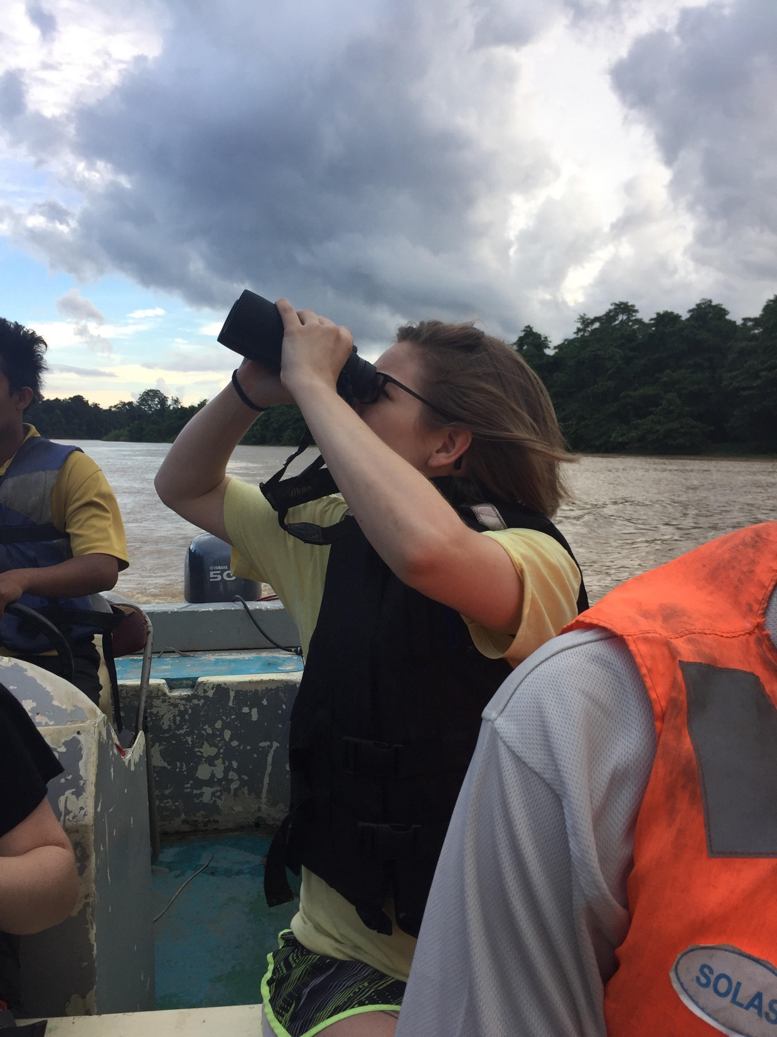

Slide 20
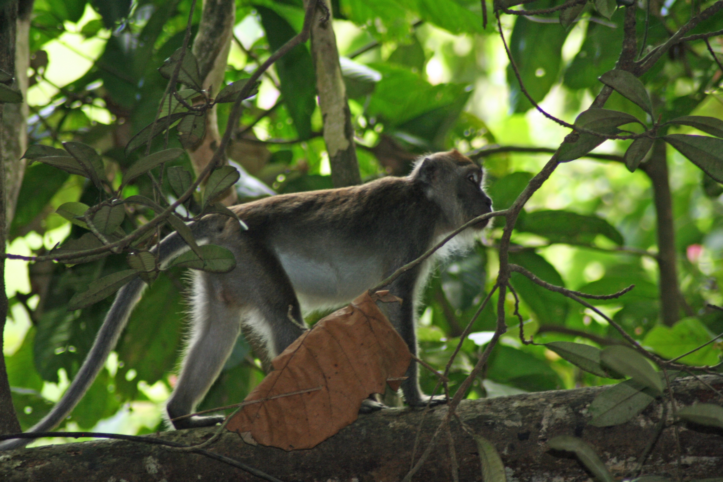

Slide 21
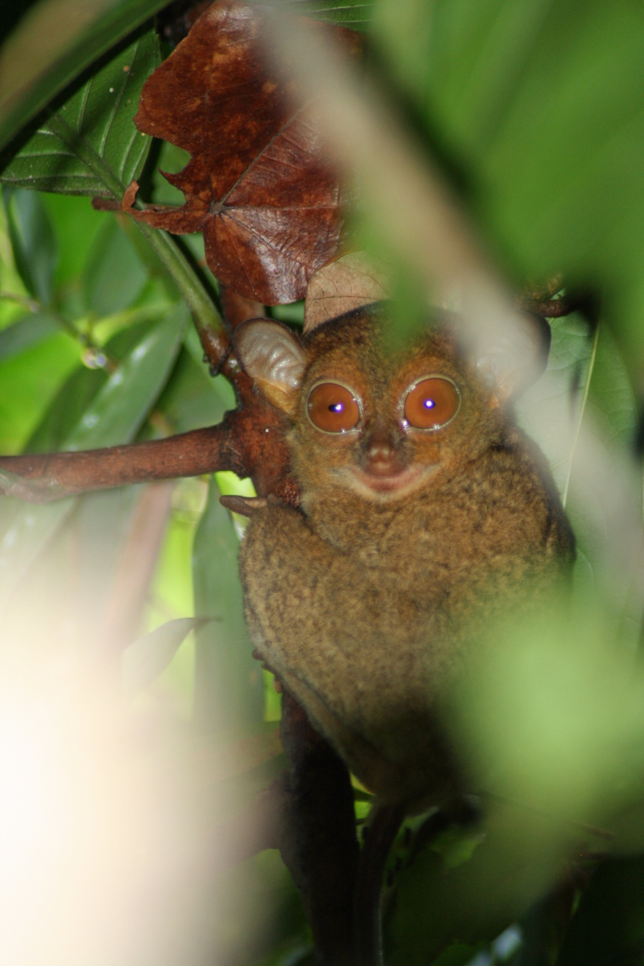
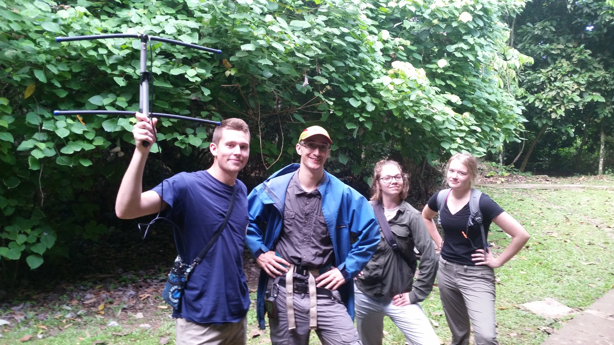
Research tools: Apply in small groups

Slide 22
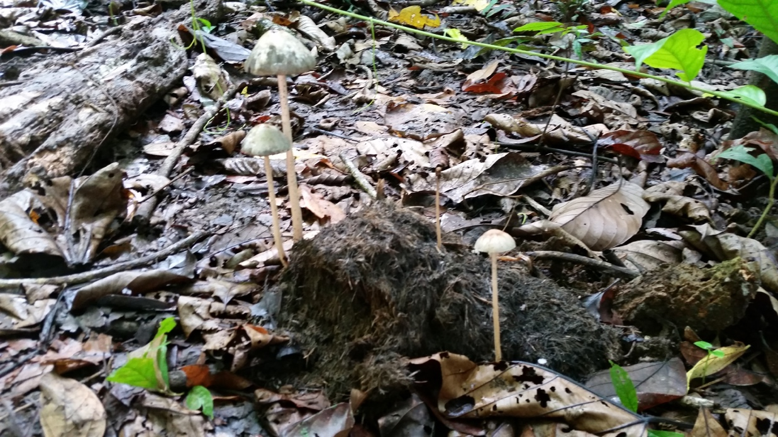
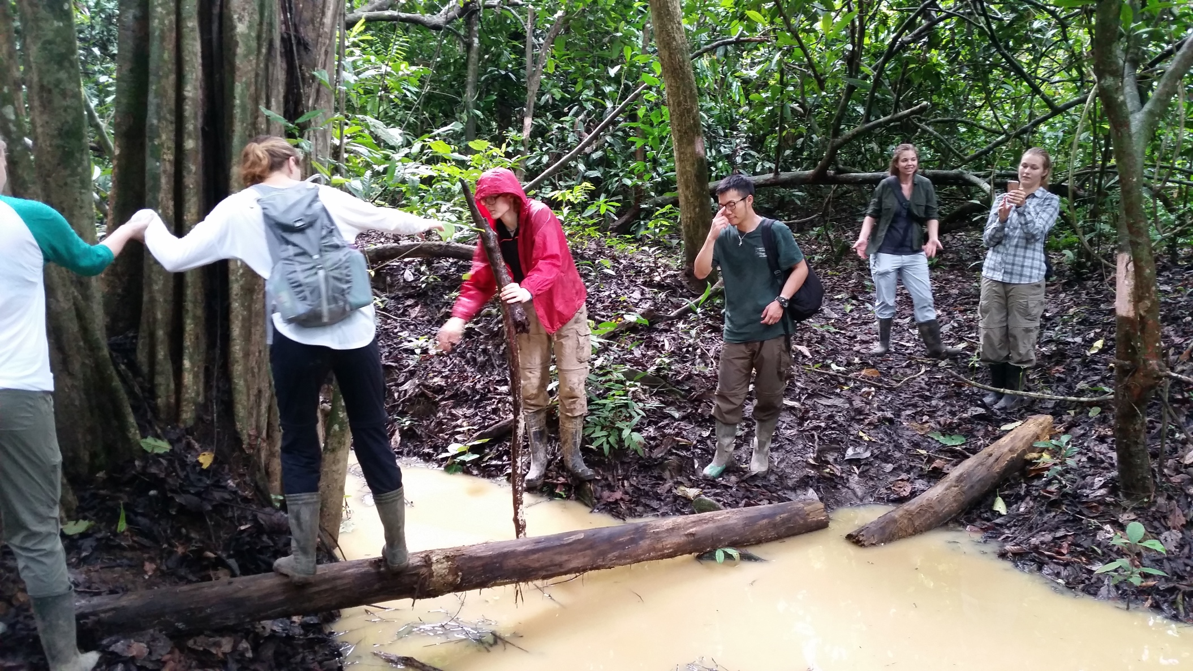
Research tools: Apply in small groups

Slide 23
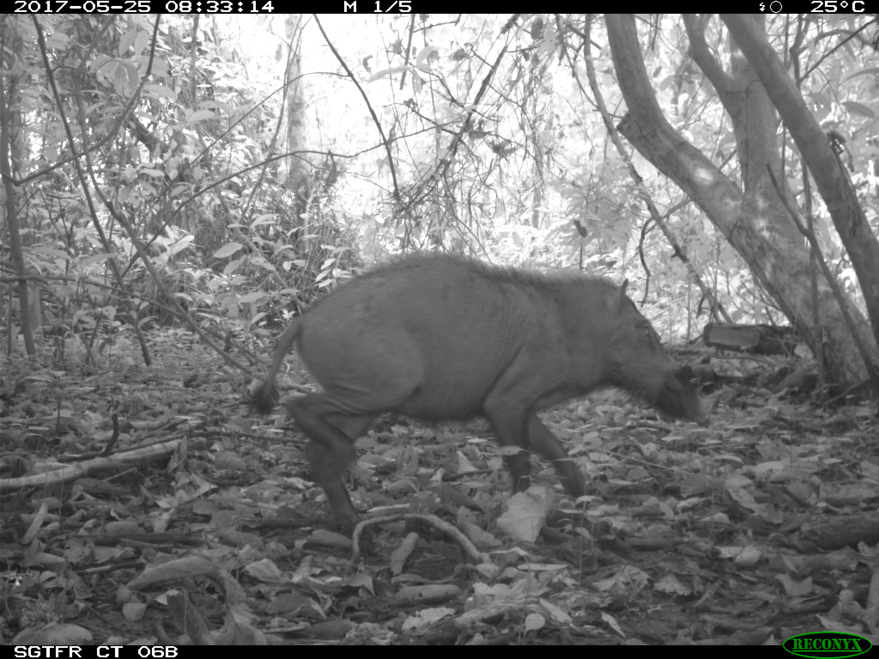
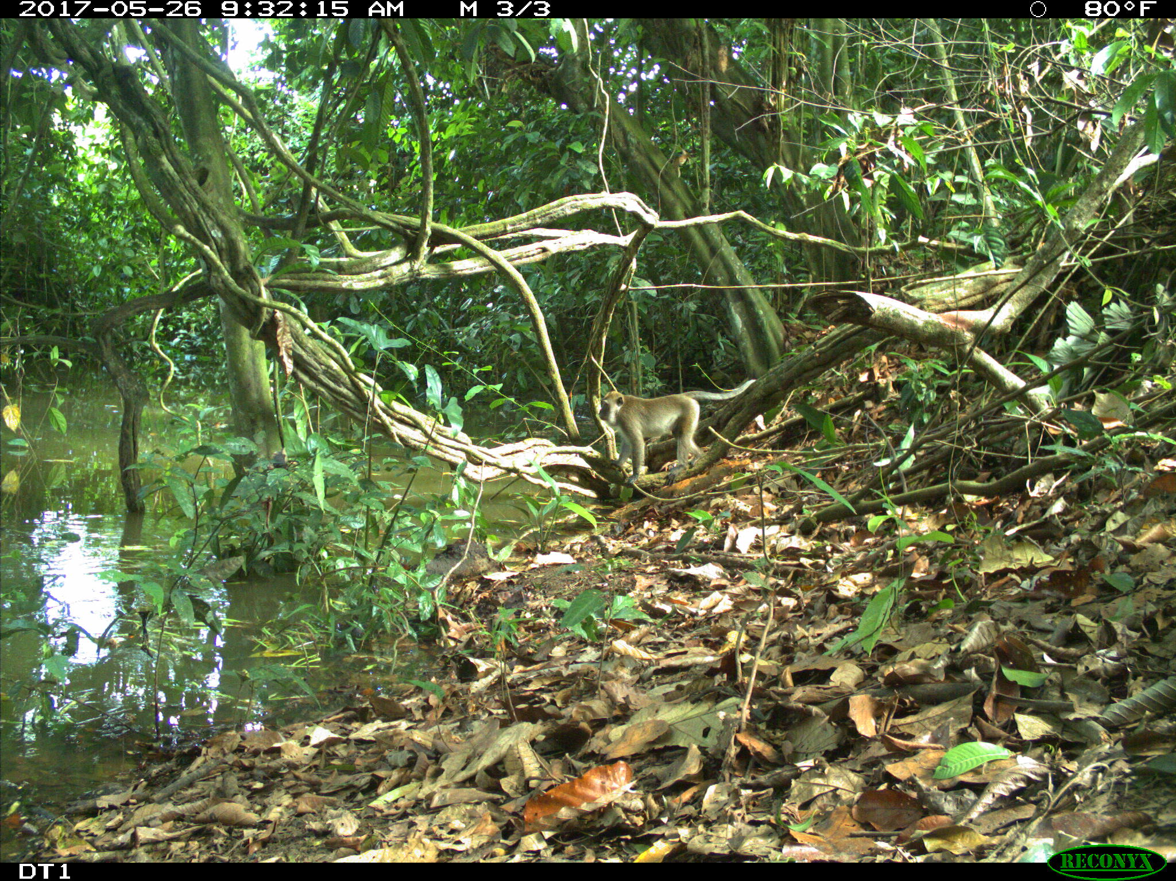
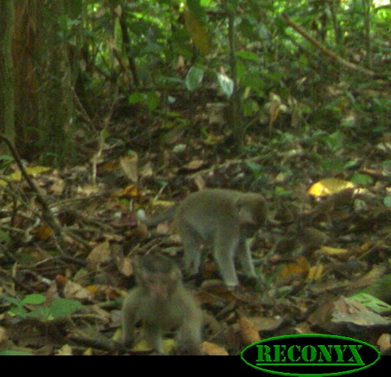
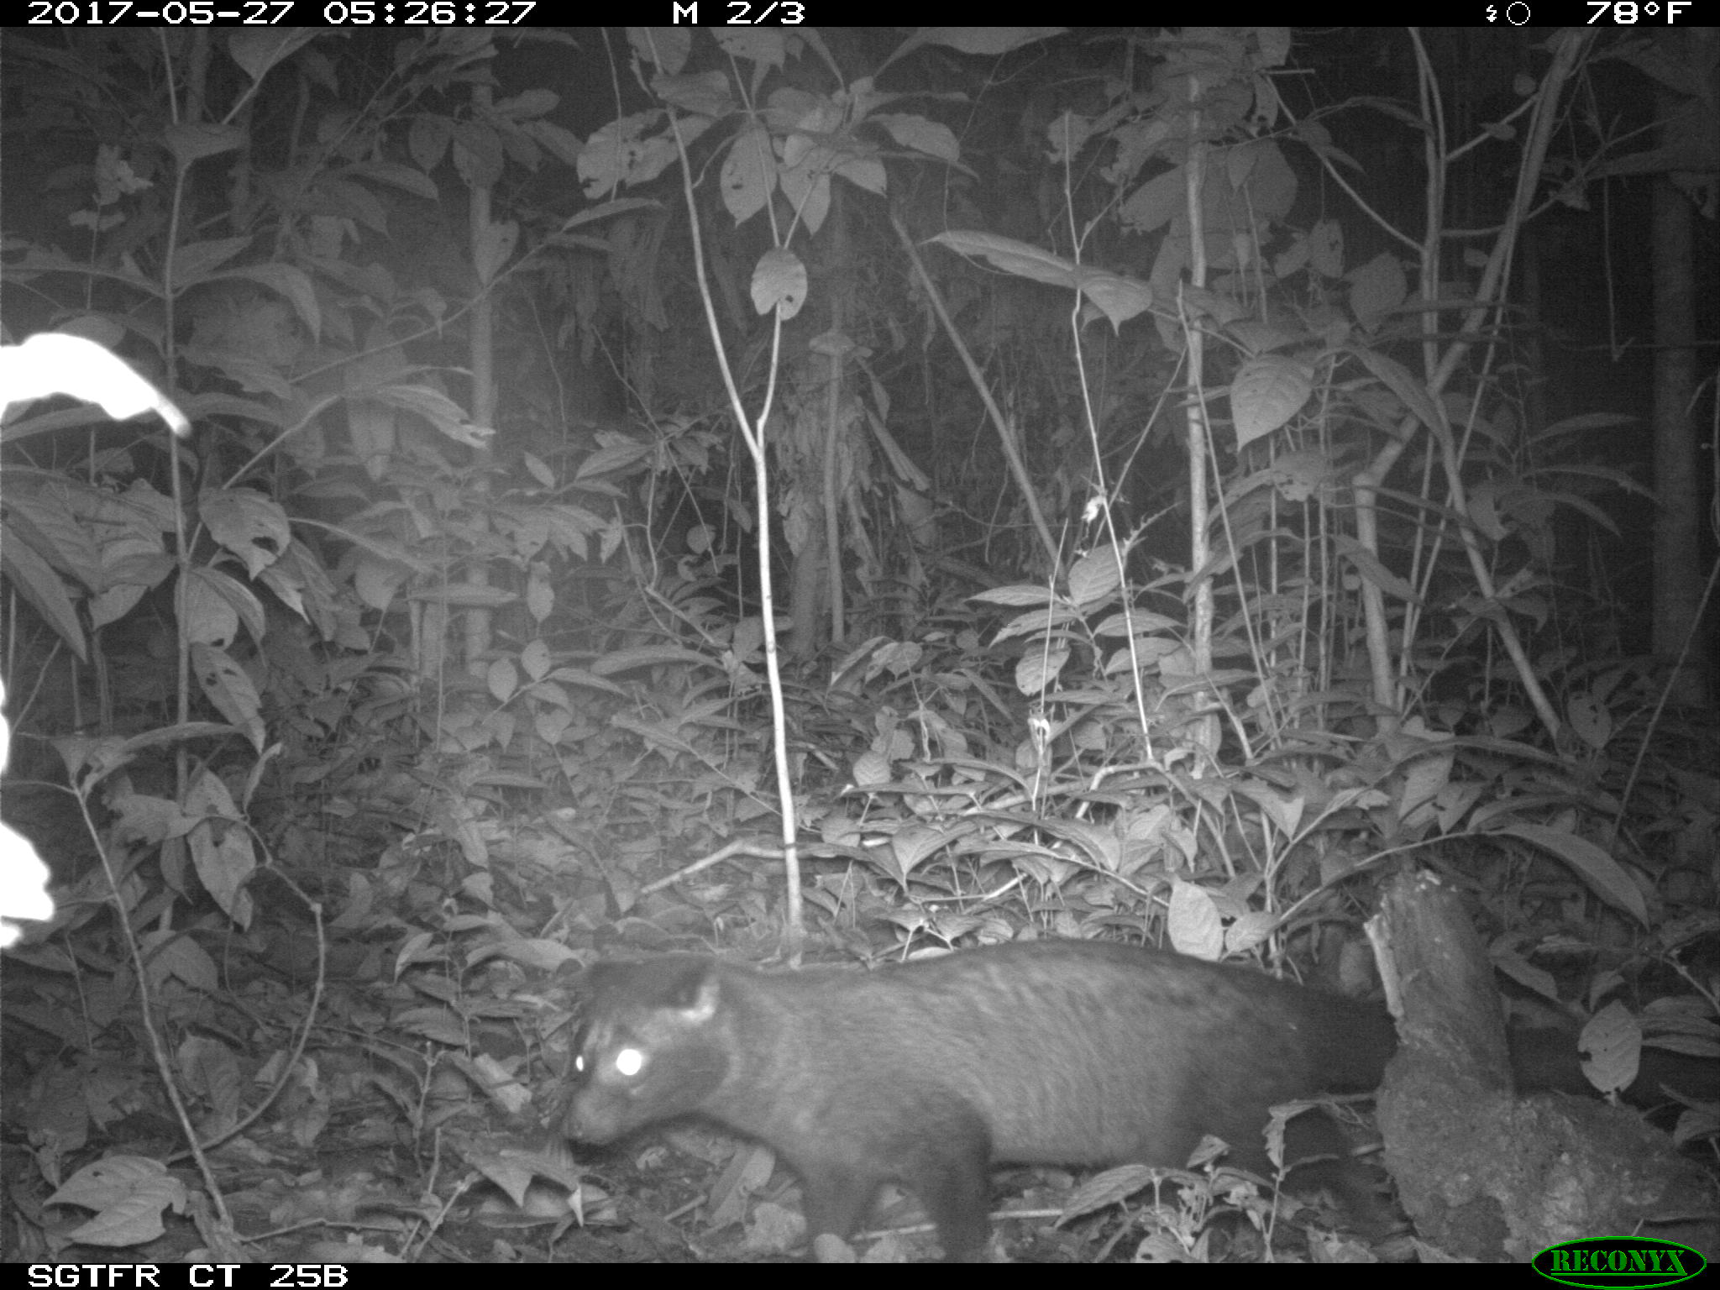
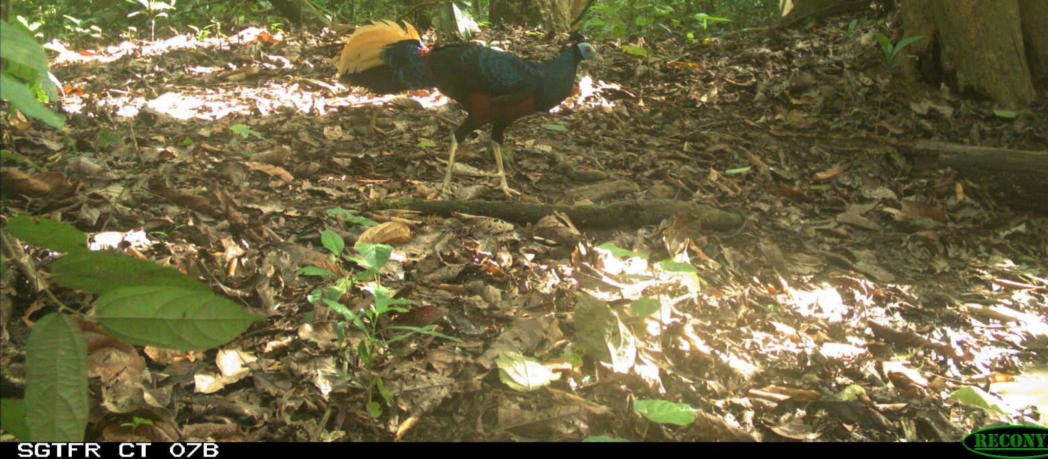

Slide 24
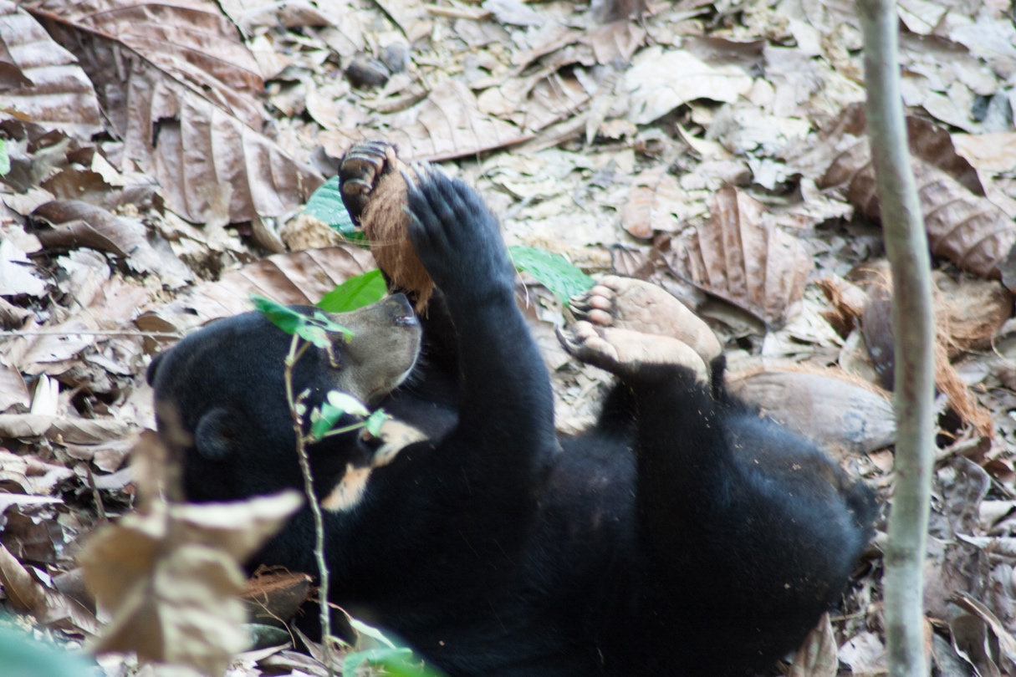
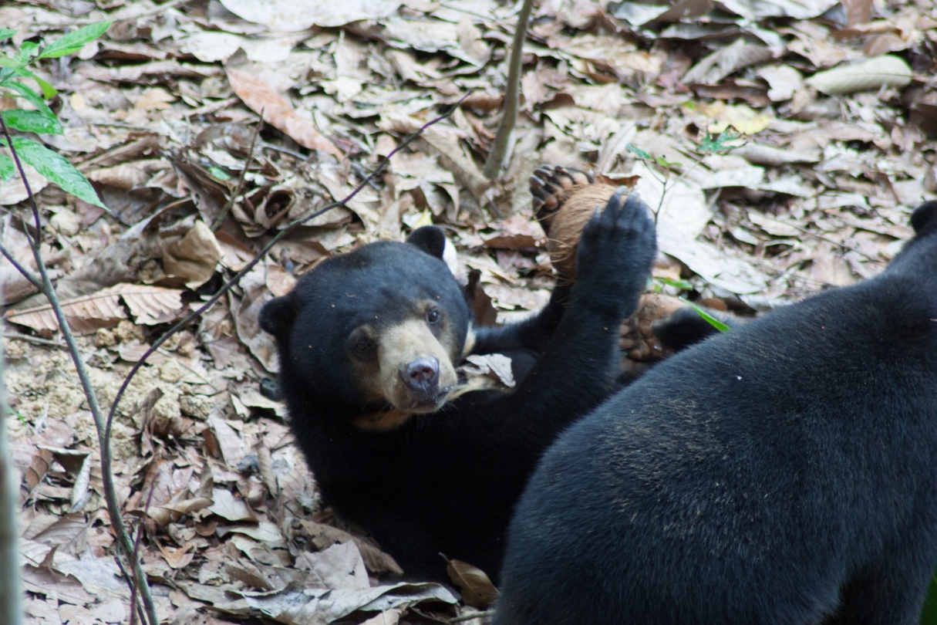
Captive animal behavior: Increased focus on results
Revisit sampling methods in a new scenario
Design an enrichment object
Use experimental tools to design sampling protocol, identify new behavior codes relevant to object, and carry out experiment
Still difficult, new obstacles, focus on results as much as possible and ID ways to overcome obstacles (like before)

Slide 25
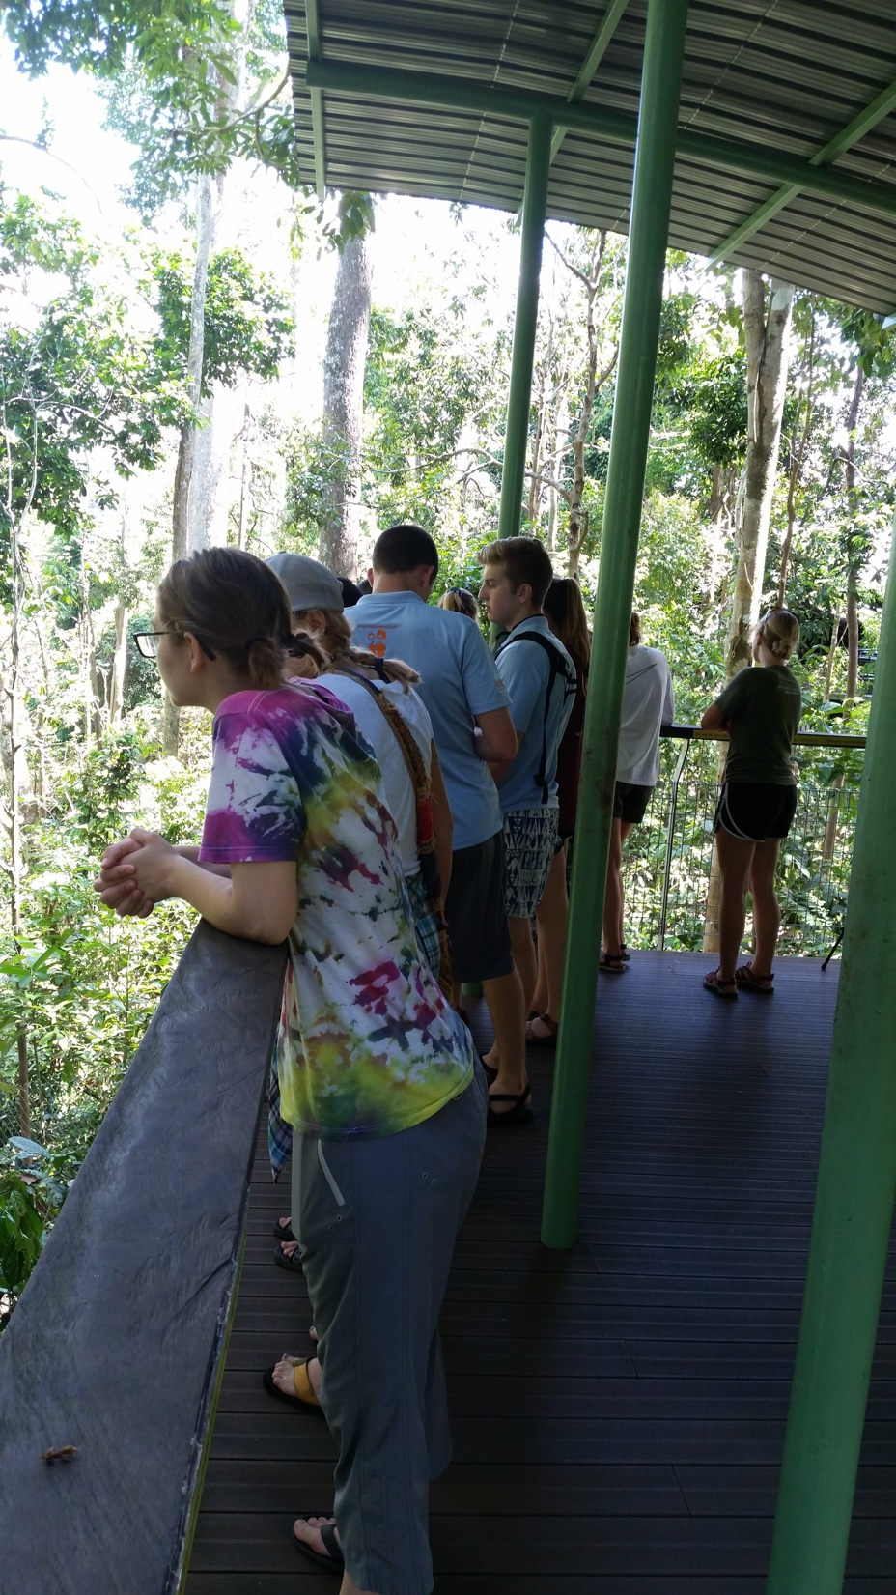
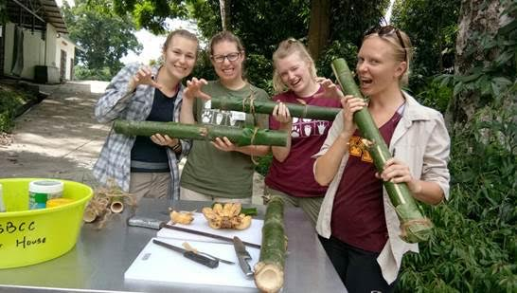
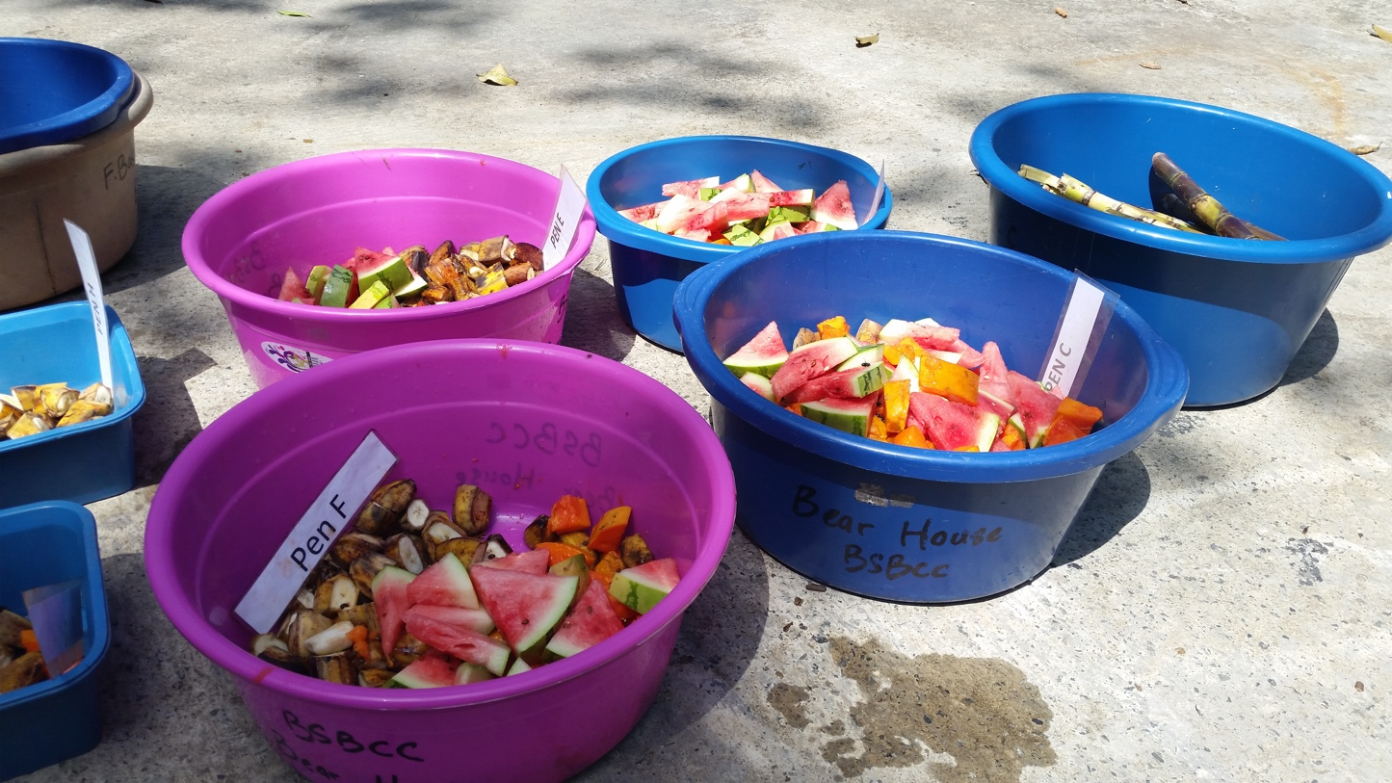

Slide 26
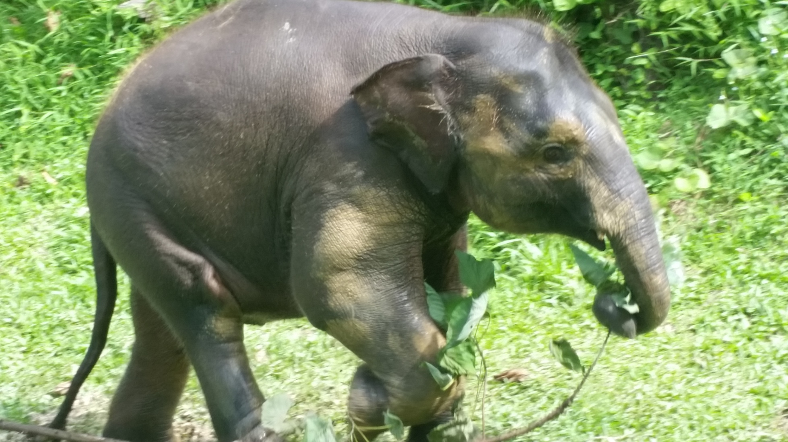
Translate peer-reviewed research through outreach

Slide 27
